Slide 1
Return-to-libc Attacks

Slide 2
Outline
Non-executable Stack countermeasure
How to defeat the countermeasure
Tasks involved in the attack
Function Prologue and Epilogue
Launching attack

Slide 3
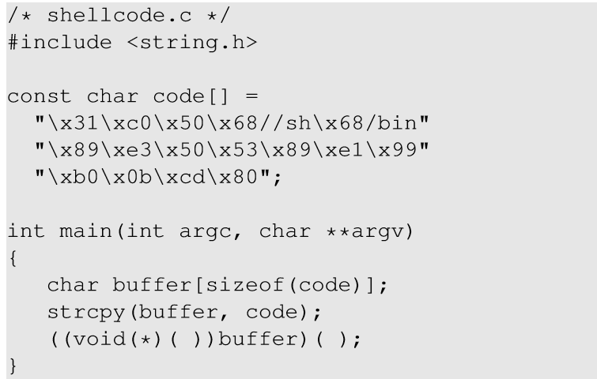
Non-executable Stack
Running shellcode in C program
Calls shellcode
Notes:
Consider the above code that places a shellcode in a buffer on the stack, casts the buffer as a function and calls the function.

Slide 4
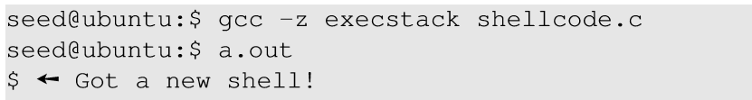
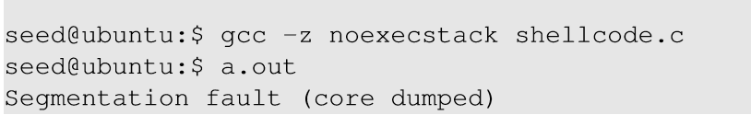
Non-executable Stack
With executable stack
With non-executable stack
Notes:
title

Slide 5
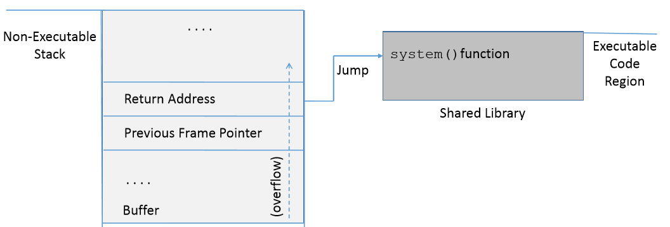
How to Defeat This Countermeasure
Jump to existing code: e.g. libc library.
Function: system(cmd): cmd argument is a command which gets executed.

Slide 6
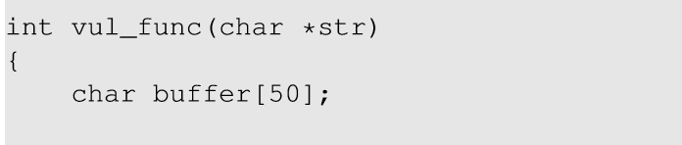
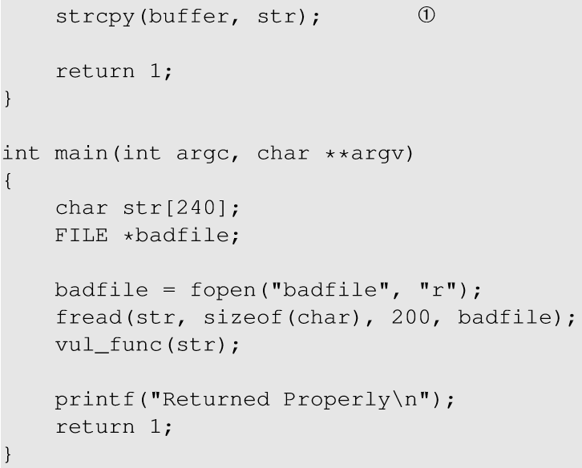
Environment Setup
char buffer[100];
This code has potential buffer overflow problem in vul_func()
Buffer overflow problem

Slide 7
Environment Setup
“Non executable stack” countermeasure is switched on, StackGuard protection is switched off and address randomization is turned off.
Root owned Set-UID program.

Slide 8
Overview of the Attack
Task A : Find address of system().
To overwrite return address with system()’s address.
Task B : Find address of the “/bin/sh” string.
To run command “/bin/sh” from system()
Task C : Construct arguments for system()
To find location in the stack to place “/bin/sh” address (argument for system())

Slide 9
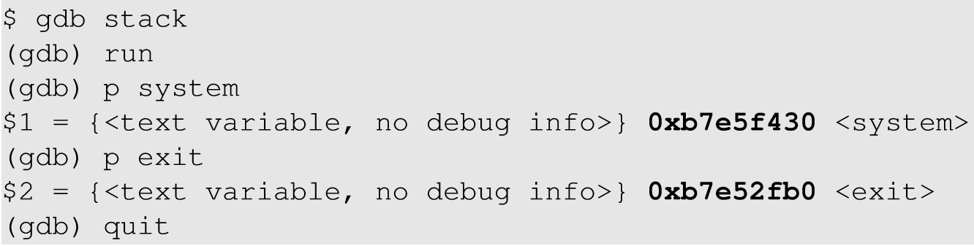
Task A : To Find system()’s Address.
Debug the vulnerable program using gdb
Using p (print) command, print address of system() and exit().
Notes:
Libc library is loaded in the memory when a program runs. For the same program, the library is loaded in the same location. Hence, we can use gdb to find the location of the library functions.

Slide 10
Task B : To Find “/bin/sh” String Address
Export an environment variable called “MYSHELL” with value “/bin/sh”.
MYSHELL is passed to the vulnerable program as an environment variable, which is stored on the stack.
We can find its address.
Notes:
The exported environment variables in the shell process is always passed to the child process.Hence, when a new environment variable is exported and vulnerable program is run, the environment variable is passed to the vulenarbale code and hence, in it’s memory.

Slide 11
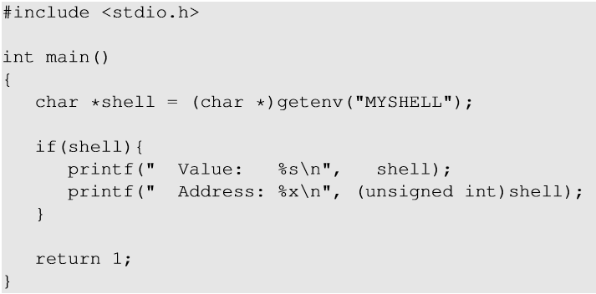
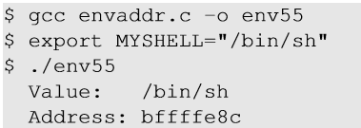
Task B : To Find “/bin/sh” String Address
Code to display address of environment variable
Export “MYSHELL” environment variable and execute the code.

Slide 12
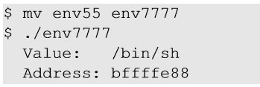
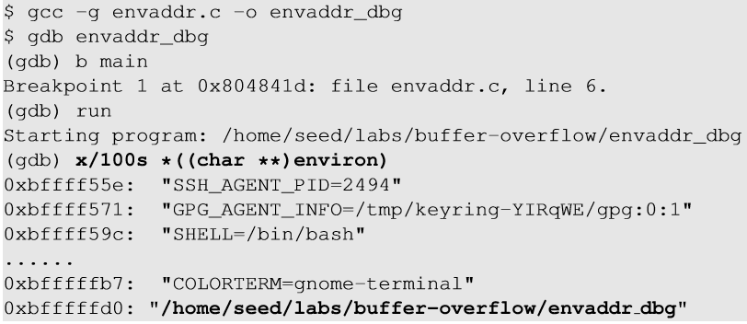
Task B : Some Considerations
Address of “MYSHELL” environment variable is sensitive to the length of the program name.
If the program name is changed from env55 to env77, we get a different address.
env55 ⬄ stack
Notes:
Environment variables are stored in the stack region of the process, but before the environment variables are pushed, the name of the program is pushed first which affects the memory locations of the environment variables. It took us quite a while to figure out why simply changing the file name can make the attack fail.

Slide 13
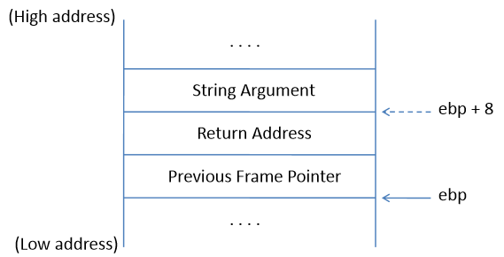
Task C : Argument for system()
Arguments are accessed with respect to ebp.
Argument for system() needs to be on the stack.
Need to know where exactly ebp is after we have “returned” to system(), so we can put the argument at ebp + 8.
Frame for the system() function

Slide 14
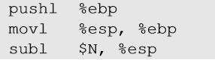
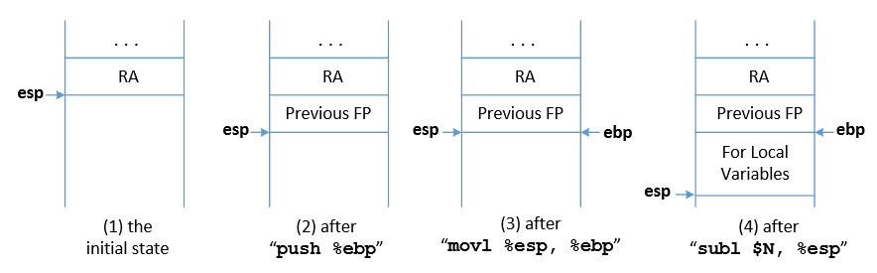
Task C : Argument for system()
Function Prologue
esp : Stack pointer
ebp : Frame Pointer
Notes:
The start of the function call contains 3 instructions as mentioned.
When a function is called, return address (RA) is pushed into the stack. This is the beginning of the function before function prologue gets executed. The stack pointer (esp register) points at RA location.
The previous frame pointer is pushed in the stack, so when the function returns, the caller’s frame pointer is recovered.
The stack pointer now points to the previous frame pointer. The frame pointer (ebp) is pointed to the current stack pointer now so that the frame pointer always points to the old frame pointer.
The stack pointer now moves by N bytes to leave space for the local variables of the function.

Slide 15
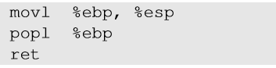
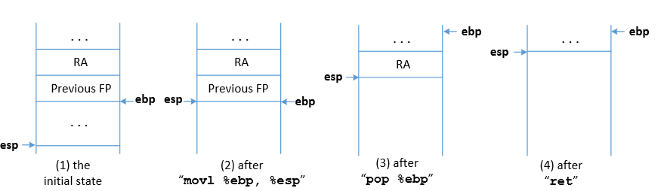
Task C : Argument for system()
Function Epilogue
esp : Stack pointer
ebp : Frame Pointer
Notes:
The stack pointer now points where the frame pointer points to in order to release the stack space allocated for the local variables.
The previous frame pointer is assigned to %ebp to recover the frame pointer of the caller’s function.
The return address is popped from the stack and the program jumps to that address. This instruction moves the stack pointer.

Slide 16
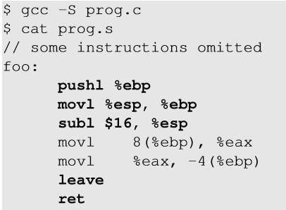
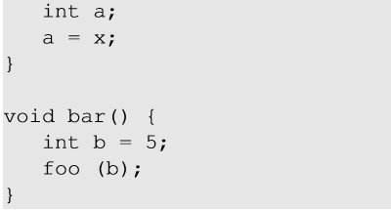
Function Prologue and Epilogue example
1
Function prologue
Function epilogue
2
1
2
8(%ebp) ⇒ %ebp + 8
Notes:
The code can be compiled into assembly code using gcc -s.

Slide 17
How to Find system()’s Argument Address?
Change ebp and esp
Modified Return Address
vul_func() epilogue
system() prologue
Use of system()’s argument
In order to find the system() argument, we need to understand how the ebp and esp registers change with the function calls.
Between the time when return address is modified and system argument is used, vul_func() returns and system() prologue begins.

Slide 18
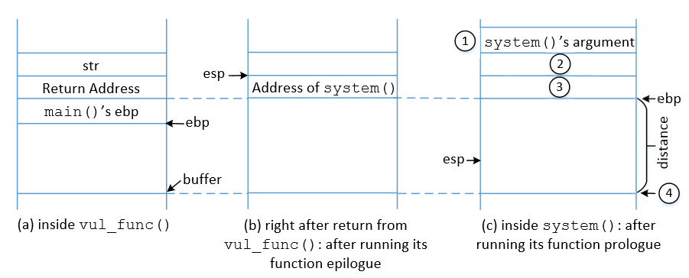
Memory Map to Understand system() Argument
Observation: system()’s ebp is only 4 bytes above vul_func()’s ebp. We can put the system()’s argument at 8 bytes above the new ebp.

Slide 19

Flow Chart to understand
system() argument
Return address is changed to system() address.
eps is replaced by ebp after vul_func() epilogue
Jump to system()
“/bin/sh” is stored in ebp+8
ebp is set to current value of esp
system() prologue is executed
Check the memory map
ebp + 4 is treated as return address of system(). We can put exit() address so that on system() return exit() is called and the program doesn’t crash.

Slide 20
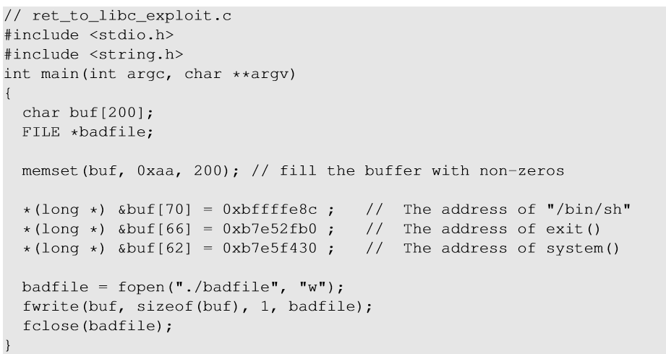
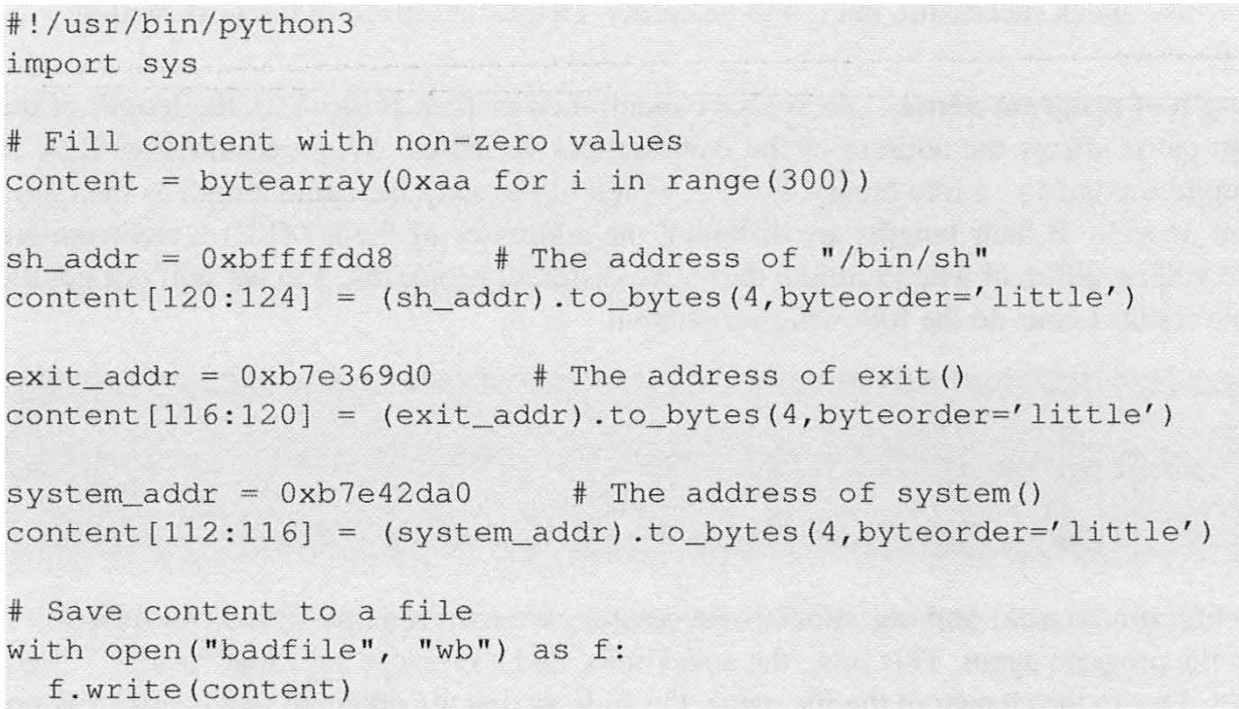
Malicious Code
Starting from vul_func()’s ebp
ebp + 12
ebp + 8
ebp + 4
Notes:
We are inside the vulnerable function (before return occurs), so ebp currently points to the stack frame of the vulnerable function.

Slide 21
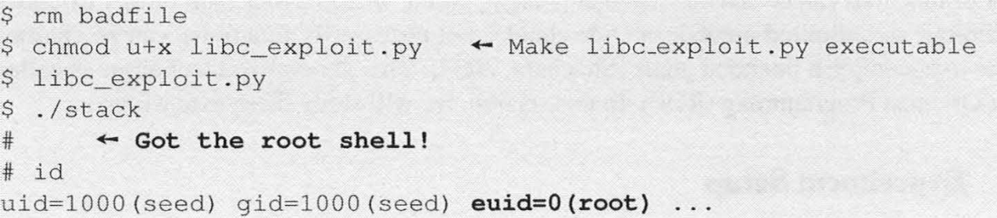
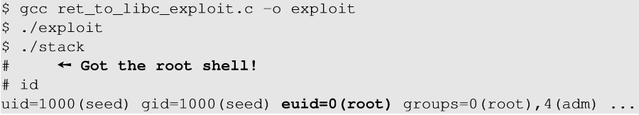
Launch the attack
Execute the exploit code and then the vulnerable code

Slide 22
Return-Oriented Programming
In the return-to-libc attack, we can only chain two functions together
The technique can be generalized:
Chain many functions together
Chain blocks of code together
The generalized technique is called Return-Oriented Programming (ROP)

Slide 23
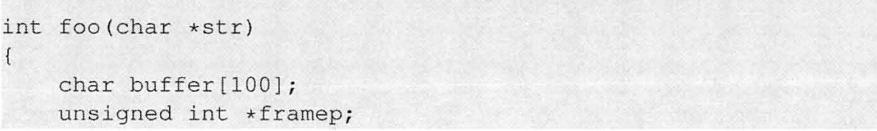
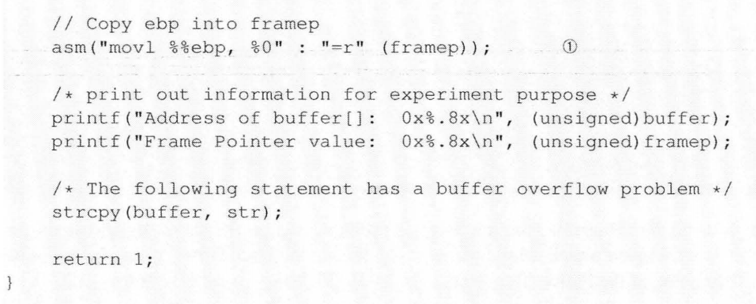
Vulnerable program stack_rop.c
Same as previous version but also prints out %ebp and buffer address

Slide 24
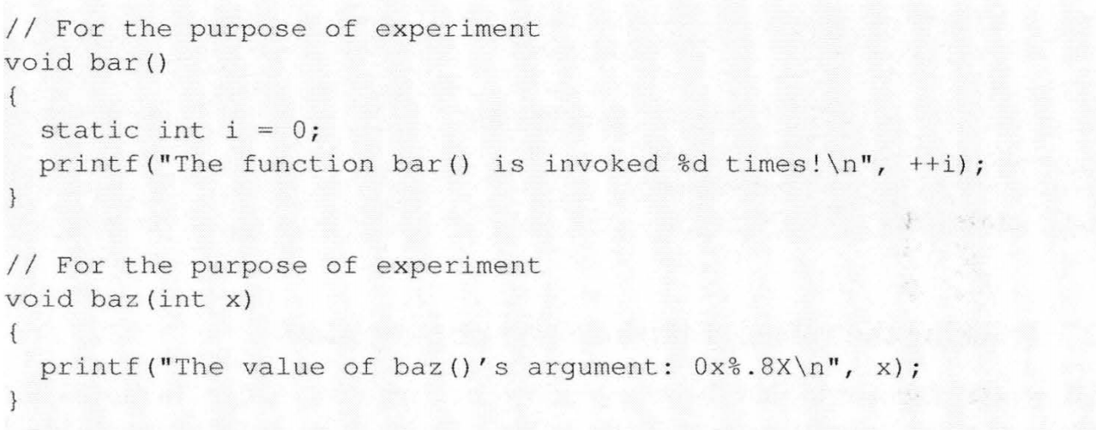
Vulnerable program stack_rop.c

Slide 25
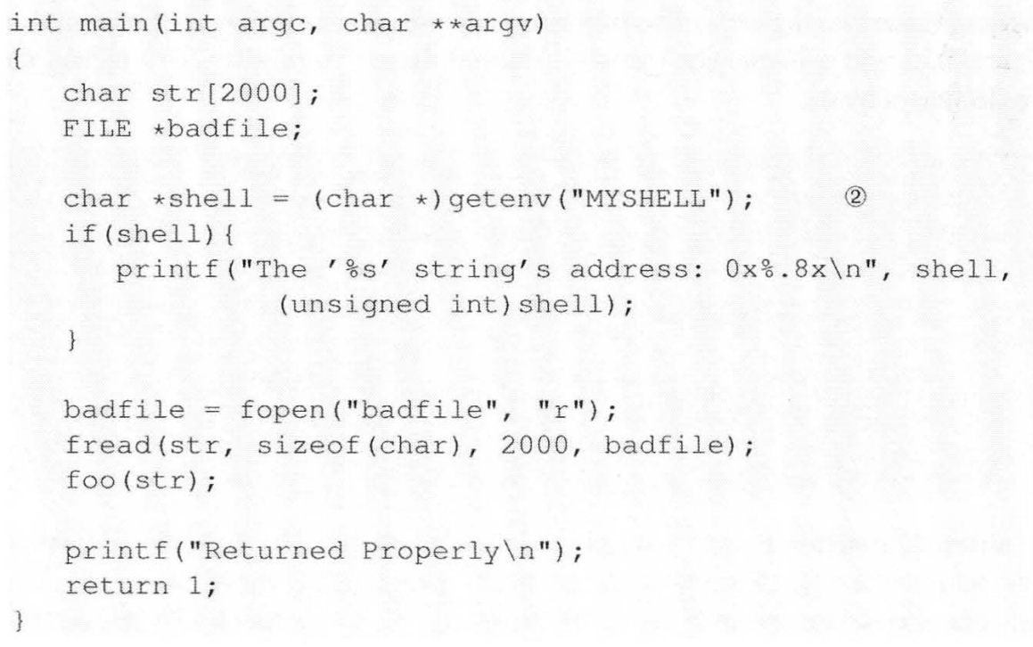
Vulnerable program stack_rop.c
Same as previous version but also prints out $MYSHELL address, and badfile size is larger

Slide 26
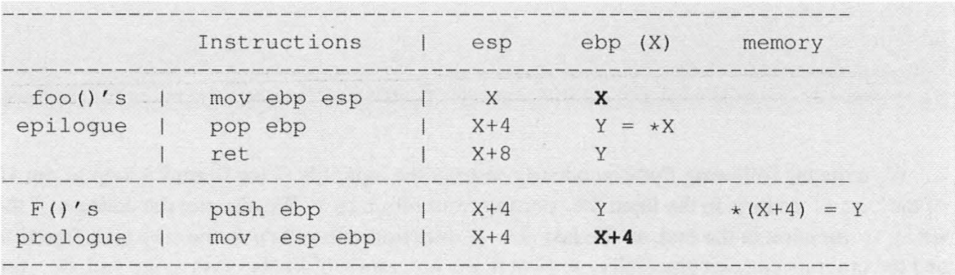
Tracking the values of the esp and ebp
After foo () returns to F () , the ebp register‘s value changes from X to X + 4
Observation 5.1 Assume a function A () 's return address field contains the address of the entry point of function B () , and the frame pointer of function A () points to address X. After the program returns to function B () from function A (), the frame pointer will point to address X+4 .

Slide 27
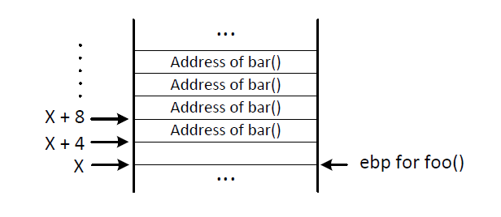
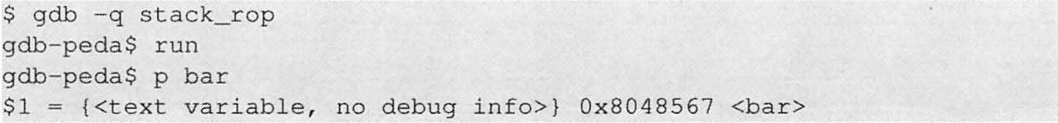
Chaining Function Calls (without Arguments)
Address of exit()
We can get the address of bar from debugging stack_rop

Slide 28
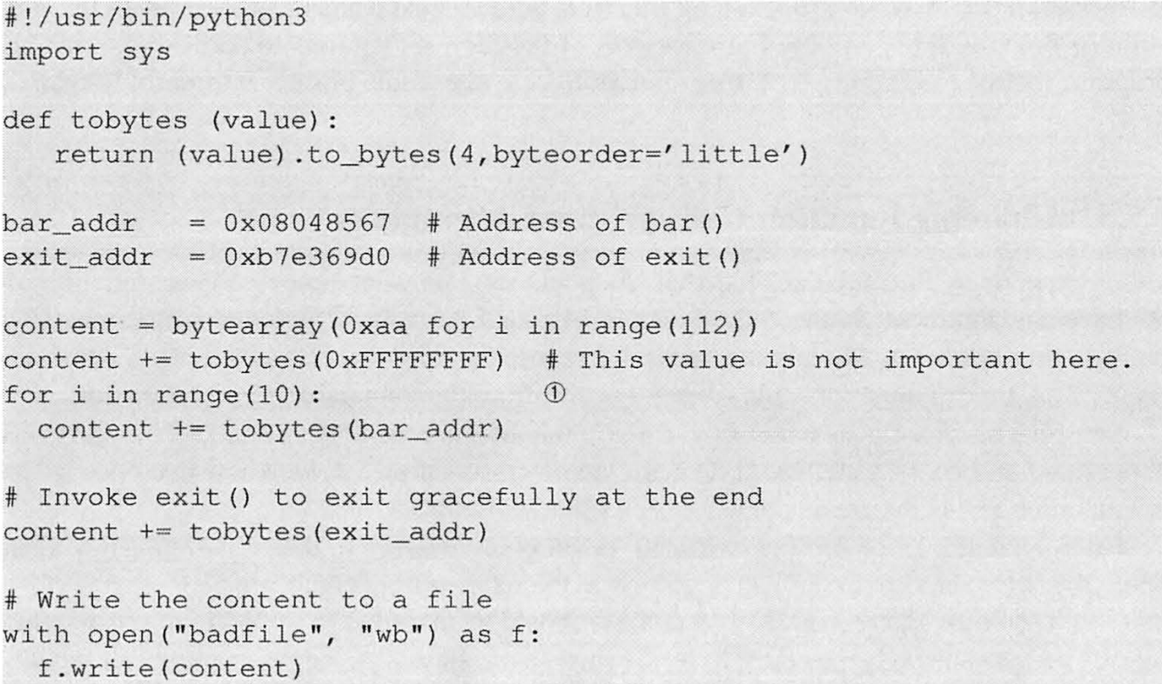
Chaining Function Calls (without Arguments)
chain_noarg.py

Slide 29
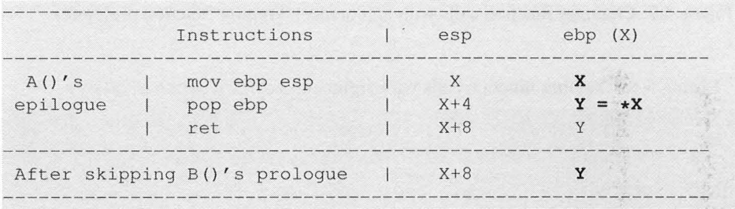
Chaining Function Calls With Arguments
The prologue of n+1th function leaves no space for arguments of the n^{th} function because instruction mov esp, ebp sets ebp to X+4, where X is the n^{th} function’s frame pointer
Idea: skip the prologue

Slide 30
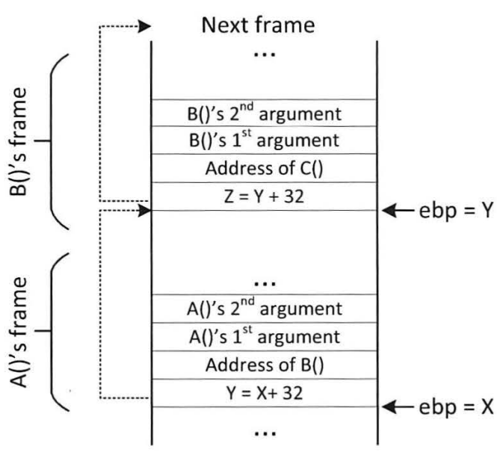
Chaining Function Calls With Arguments
Observation 5.2 Assume function A() 's return address field contains the address of the code that is right after B() 's function prologue; also assume the frame pointer of function A() points to address X. After the program returns to function B() from function A() , the frame pointer will point to address Y, where Y is the value stored at address X
+ 3
+ 3

Slide 31
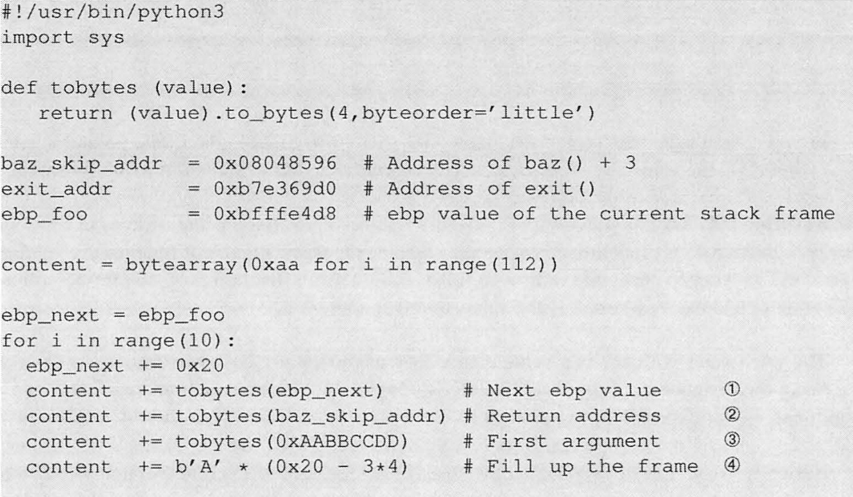
Chaining Function Calls With Arguments
chain_witharg.py

Slide 32
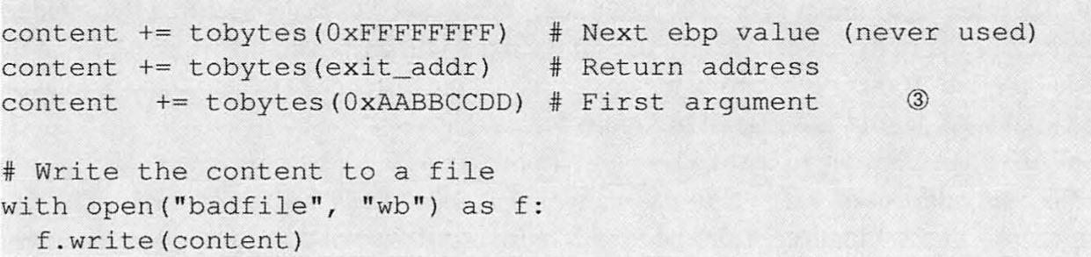
Chaining Function Calls With Arguments
chain_witharg.py
Limitation of the prologue-skipping approach: These days, library functions are invoked through Procedure Linkage Table (PLT), i.e., we do not directly jump to the entry point of these functions; we need to jump to an entry in PLT, which conducts important steps to connect to the target library function and eventually jump to its entry point. This mechanism is widely used for invoking dynamically linked libraries. Therefore, if we want to skip over the function prologue, we have to skip over all of the intermediate setup instructions inside PLT, but without the setup, it is not possible to invoke the target function.

Slide 33
Chaining Function Calls With Args: via leave and ret
X+4
Y+4
Assume function A()’s frame pointer is X+4 and its value is Y.
When function A() returns to function empty(), skipping its prologue, according to Observation 5.2, the frame pointer's value will become Y
When empty() returns to function B() , without skipping its prologue, according to Observation 5.1, the frame pointer's value will increase by four, i.e., becoming Y+4

Slide 34
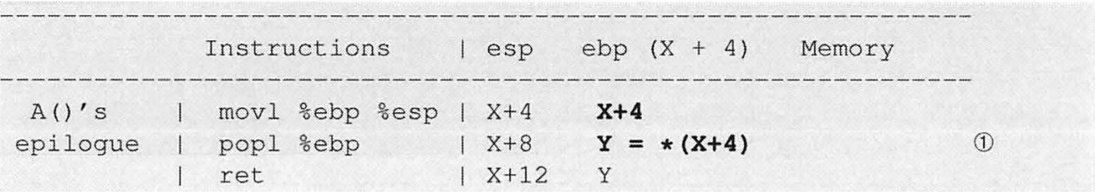
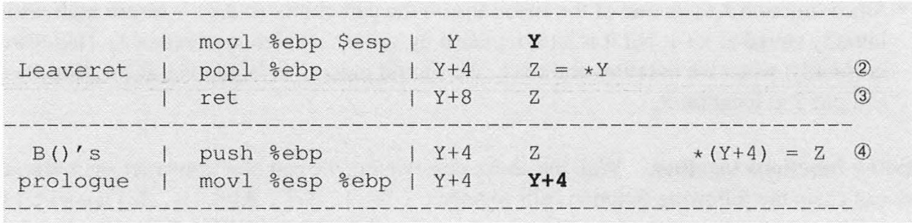
Chaining Function Calls With Args: via leave and ret
X+4
Y+4

Slide 35
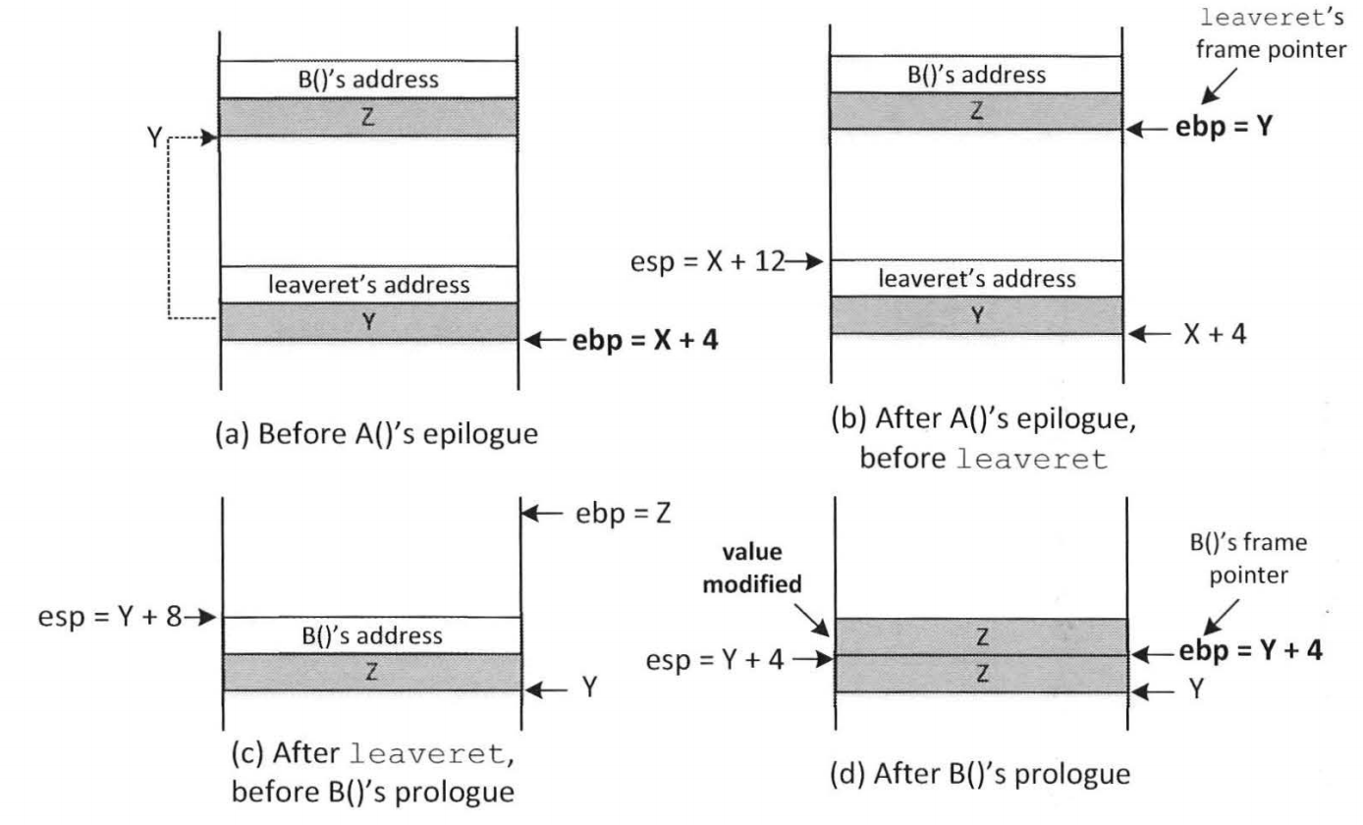
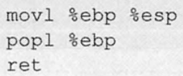
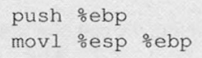

Slide 36
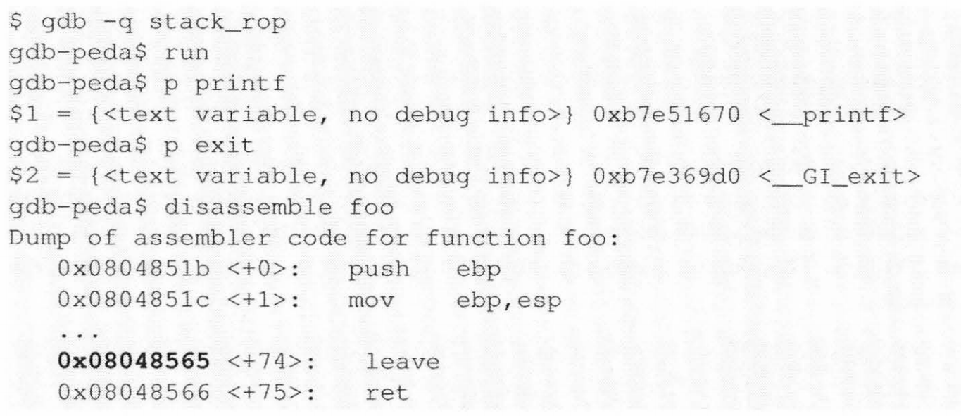
Find a leave-ret address

Slide 37
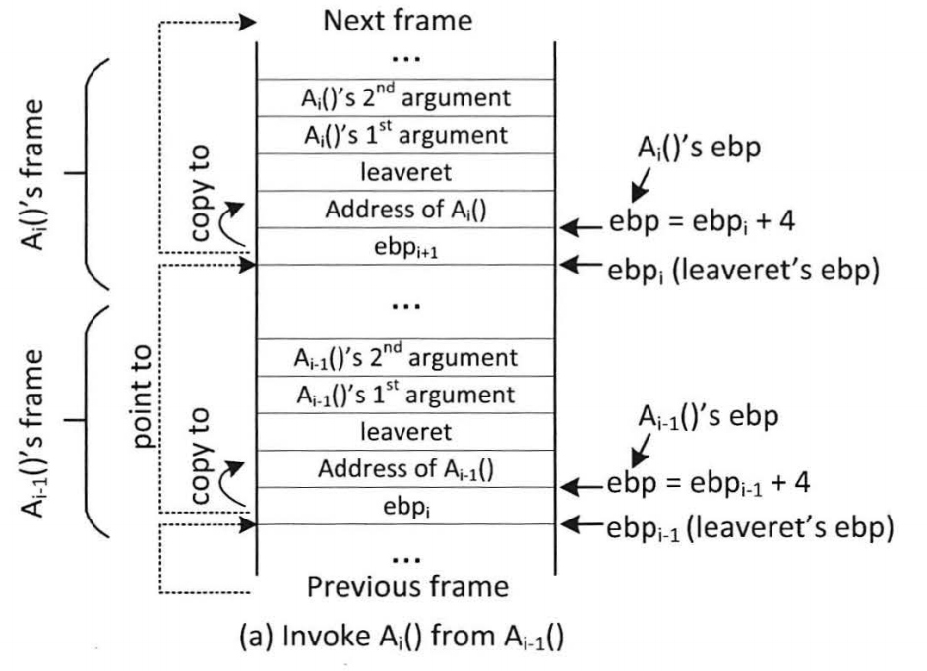
Chaining Function Calls With Args: via leave and ret
Chaining foo(), A₁(), …, A_{n}(), exit() together

Slide 38
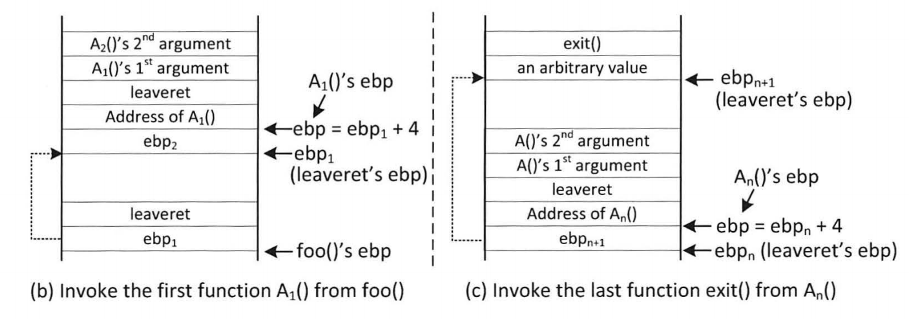
Chaining Function Calls With Args: via leave and ret

Slide 39
Chaining Function Calls with Zero in the Argument
Idea: using a function call to dynamically change argument to zero on the stack
Sequence of function calls (T is the address of the zero): use 4 sprint() to change setuid()’s argument to zero, before the setuid function is invoked.
Invoke setuid(0) before invoking system(“/bin/sh”) can defeat the privilege-dropping countermeasure implemented by shell programs.

Slide 40
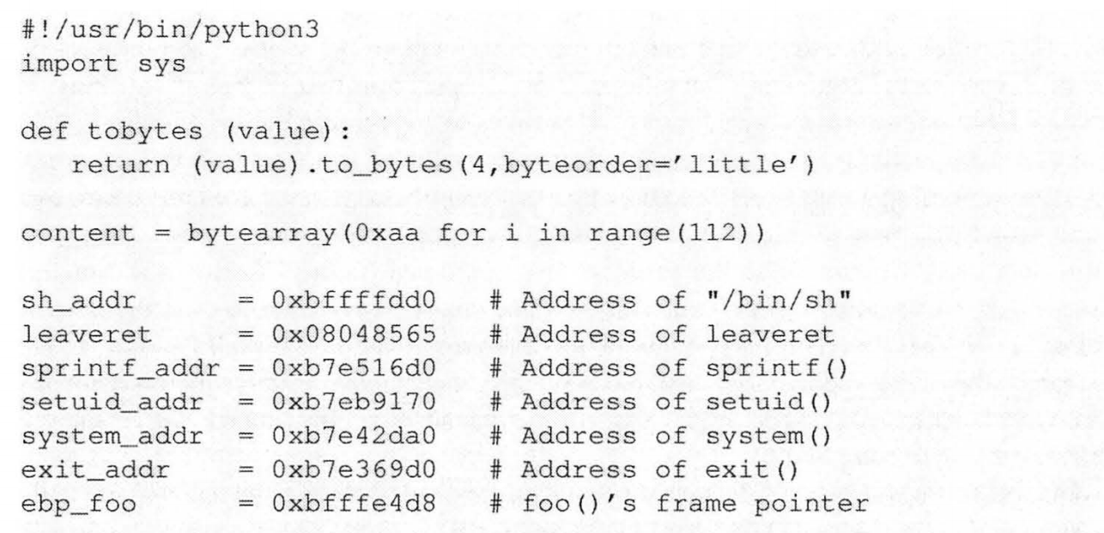
Prepare the shellcode: chain_attack.py
Chain foo() → (sprintf)⁴ → setuid(0) → system(/bin/sh) → exit()

Slide 41
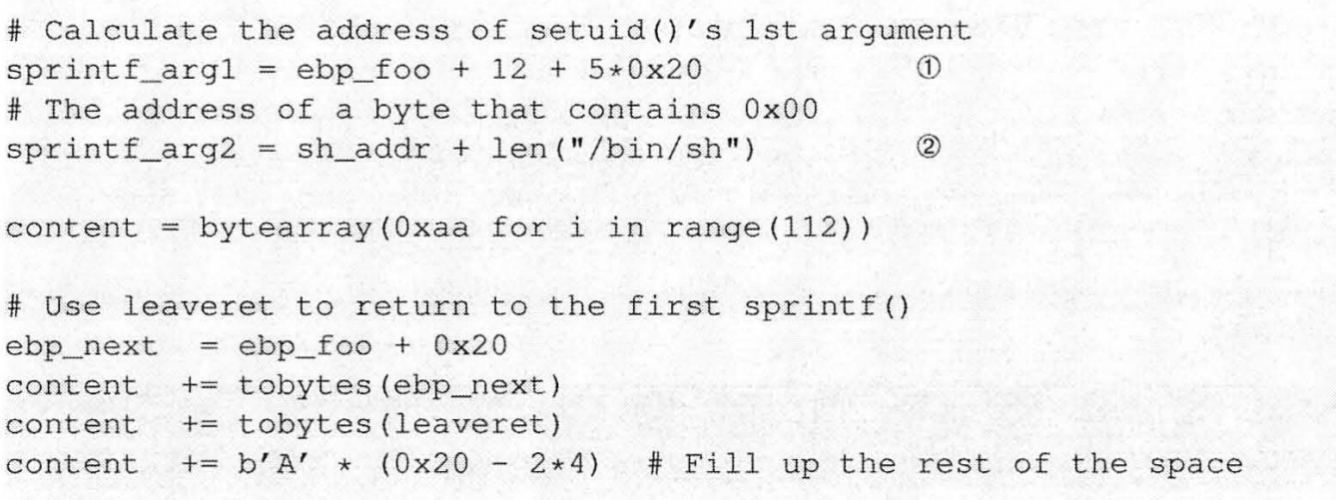
Prepare the shellcode: chain_attack.py

Slide 42
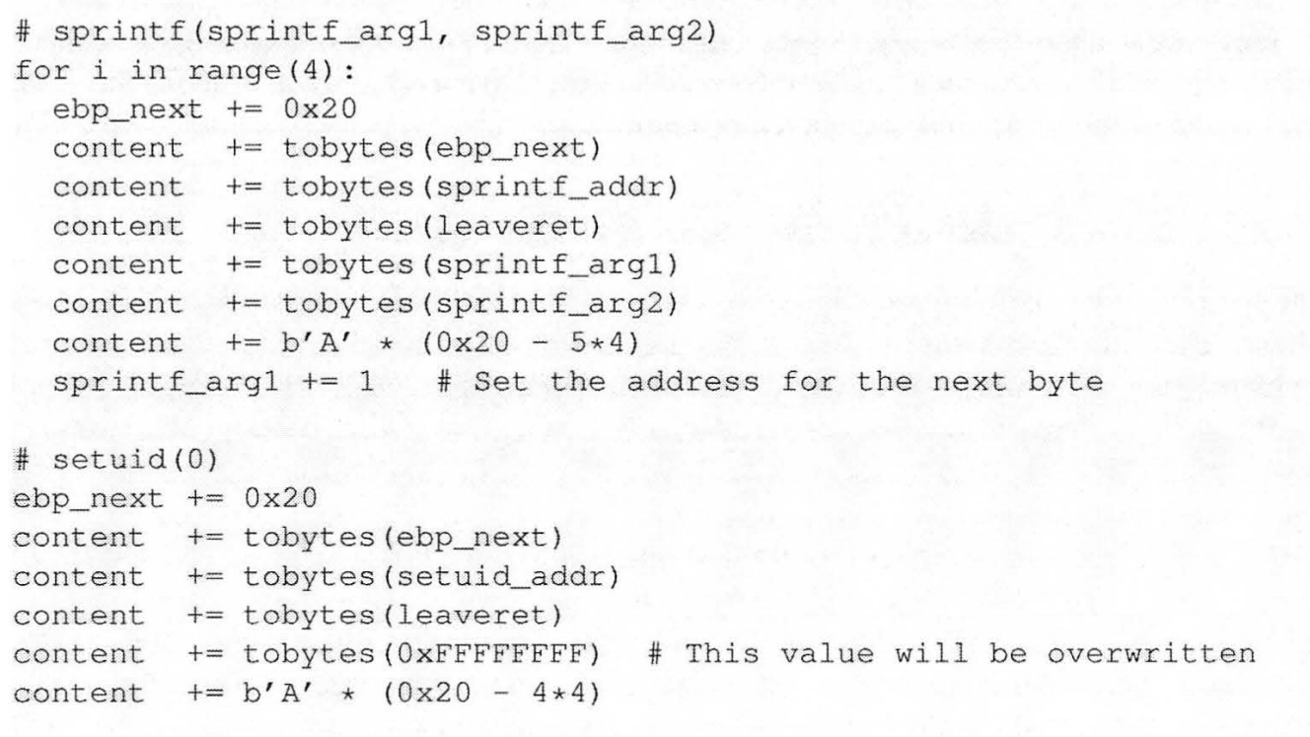
Prepare the shellcode: chain_attack.py
This value will later be set to zero by sprintf

Slide 43
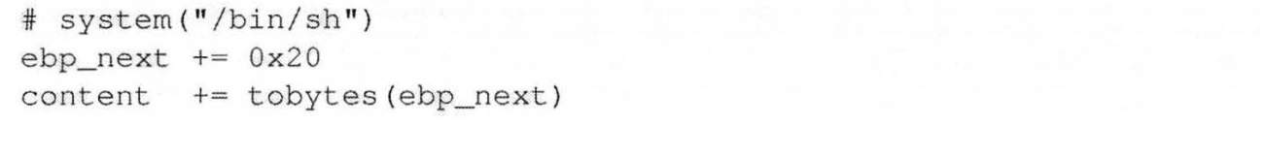
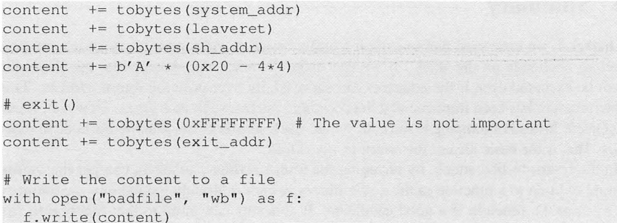
Prepare the shellcode: chain_attack.py
(PFP)

Slide 44
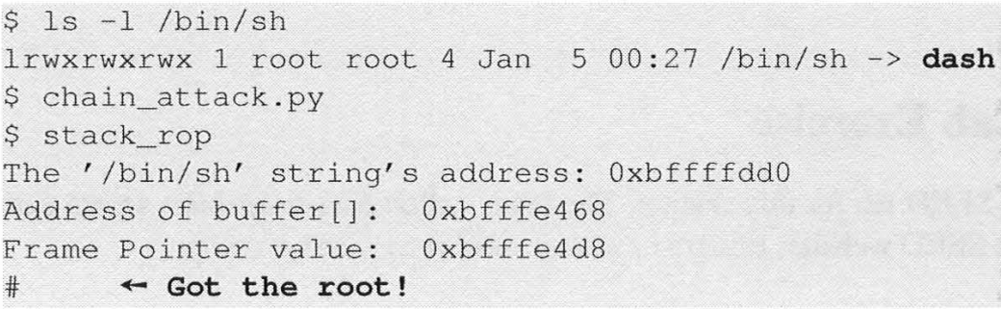
The attack

Slide 45
Summary
The Non-executable-stack mechanism can be bypassed
To conduct the attack, we need to understand low-level details about function invocation
The technique can be further generalized to Return Oriented Programming (ROP)

